Slide 1
Hackathon Presentation
Team HAKS
(Harshal, Aniket, Kumud, Swati and Amey)
31-May-2020

Slide 2
Table of Contents
Dataset Overview
Exploratory Data Analysis (EDA)
Duration Hypothesis Testing
Pipeline
Models and Approaches
Insights and Decisions
Notes:
Can we include some examples here?

Slide 3
Problem Statement
SafeTravel Inc. - Overview
Business Problem
Data Science Problem
Customers: The potential customers are travelers who want to insure themselves against travel-related risks
Products: 1-way travel insurance, 2-way insurance, insurance against cancellations
Risk: Loss of baggage, airline cancellations, health issues
Frequency: They receive thousands of claims spread across different products
Problem: Wrongly denying a genuine claim could lead to lawsuits against the company and approving the wrong claim would lead to a loss.
The Need: Automatically predicting the claims could lead to a lot of benefits and solve some other supplementary problems too
Solution Design: Build a product/model using Machine Learning to handle claims management
Approach: As a team of data scientists we need to develop a solution that focuses on increasing the precision of genuine claim disbursements
Notes:
Can we include some examples here?

Slide 4

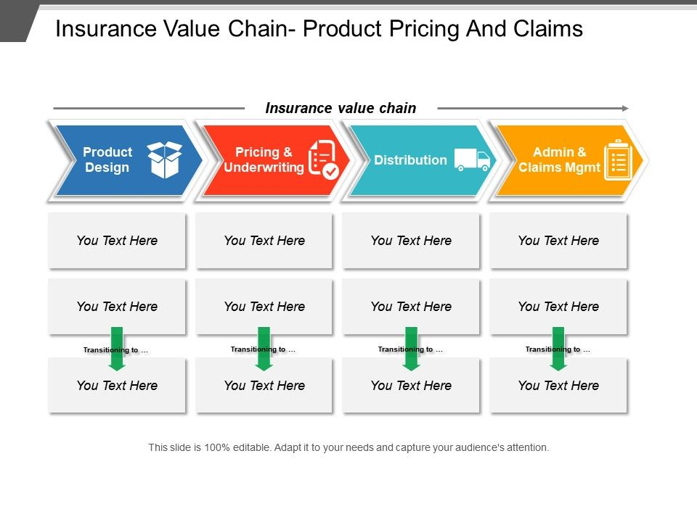


Why solve this problem?
Business Impact: Why solving this problem is important?
1
Value Chain Perspective
Focus of our current problem set
2
Reputational Impact
3
Financial Implications
4
Customer Experience
Key Stakeholders
CEO, CFO, COO & other C-level executives
The Company Board

Slide 5
Data
ID | The identification record of every observation
Agency | Name of agency
Agency Type | Type of travel insurance agencies
Distribution Channel | Distribution channel of travel insurance agencies
Product Name | Name of the travel insurance products
Duration | Duration of travel
Destination | Destination of travel
Net Sales | Amount of sales of travel insurance policies
Commission (in value) | The commission received for travel insurance agency
Age | Age of insured
Claim | Claim Status

Slide 6
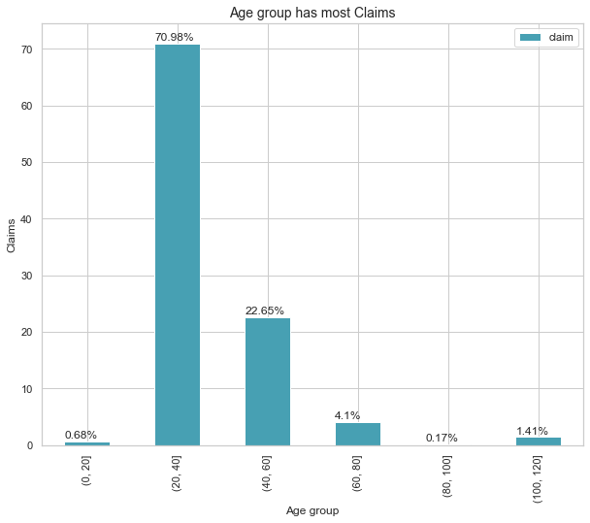
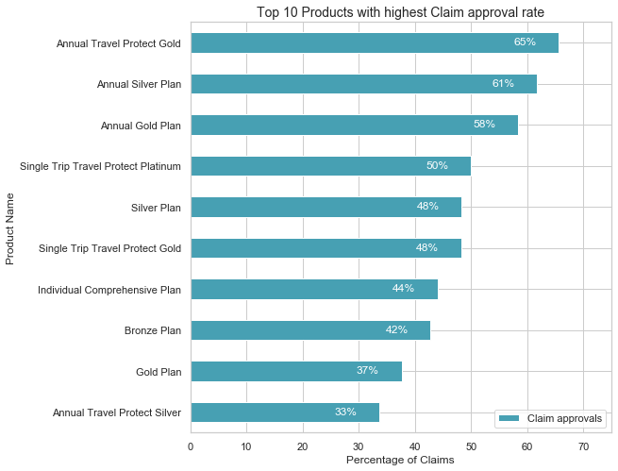
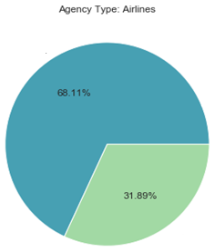
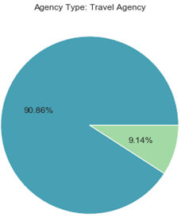

EDA: Dataset Descriptive Analytics (1/2)
Customers – Age Analysis
Product Portfolio - Analysis
Agency Type View
The maximum number of Claims are in the Age-group between 20-40 followed by 40-60.
Annual plans have comparatively higher claim approval rates as compared to single travel plans
Airlines have higher Claim approval ratio as compared to Travel Agency.
Notes:
Can we include some examples here?

Slide 7
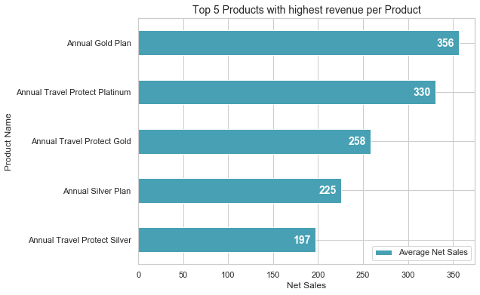
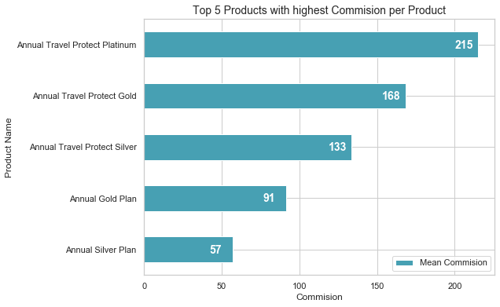
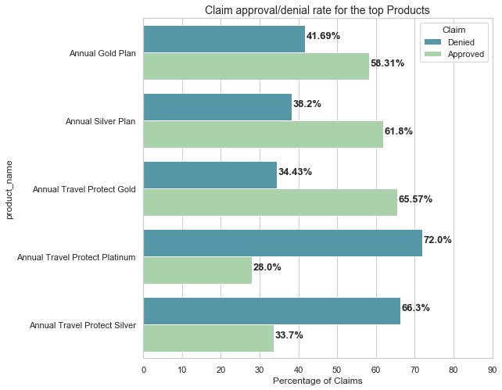
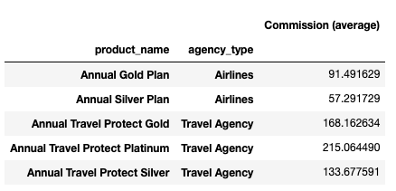
EDA: Dataset Descriptive Analytics (2/2)
Product & Net Sales Analysis
Product & Commission Analysis
Product - Claim Approval Rate
Product – Agency Type Analysis
Notes:
Can we include some examples here?

Slide 8
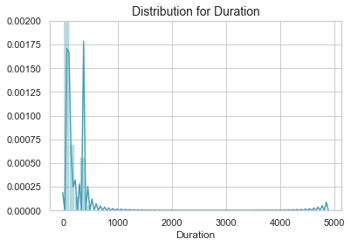
Hypothesis Testing – Duration (1/2)
Duration values are extremely distributed.
Hypothesis:
Metric for Duration is in days.
Hypothesis Testing: Distributing data-set into two parts
Duration - Less than 365(days)
Duration - More than 365(days)
Minimum value | Maximum value | Mean | Median
-2 | 4881 | 58.25 | 24

Slide 9
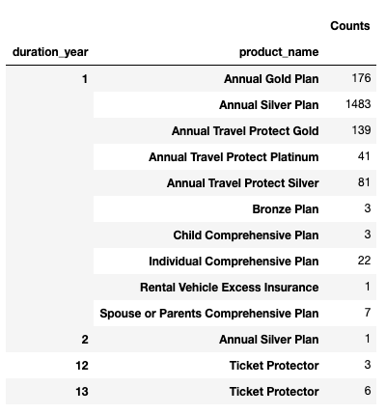
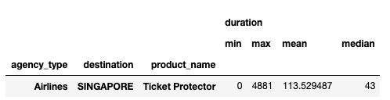
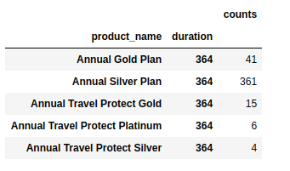
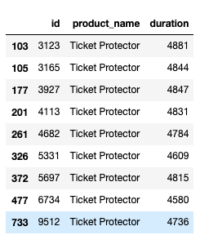
Hypothesis Testing – Duration (2/2)
Duration – More than 365 (days)
Counts of Products for Duration (converted into years).
Counts of Products for Duration (converted into years).
Majority data points lie in 1-2 year range.
Duration – Less than 365 (days)
Checking Duration of Products only for Annual plans.

Slide 10
Pipeline
Data had no null values.
Taking care of categorical features:
Multi-class categorical: Agency and Product Name - Most frequent ones were retained while rest converted to a new class “others”.
Destination: This feature has large amount of classes so “frequency count” method was used. In which actual class is replaced by it’s number of occurance.
Binary Features: Converted to numeric using get_dummies method of Pandas

Slide 11
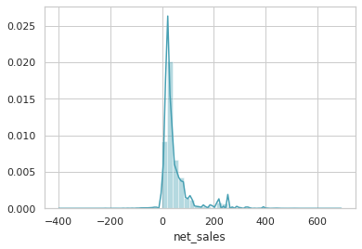
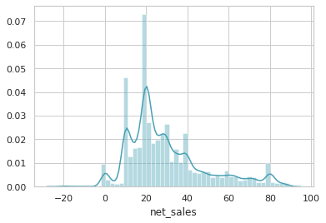
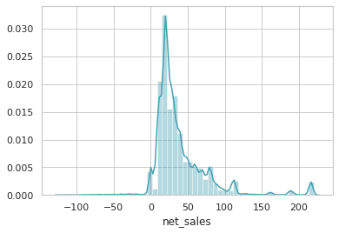
Pipeline
Taking care of Outliers
 | With outliers | IQR | Z-Score
Kurtosis | 10.87 | 0.78 | 7.99
Skew | 2.81 | 1.08 | 2.36

Slide 12
Models and Approaches
Multiple classification models were run on the data: Here are some numbers.
 | Logistic Regression | Random Forest | Decision Tree | Gradient Boosting | XGBoost
Precision | 0.55 | 0.70 | 0.60 | 0.68 | 0.78
Recall | 0.18 | 0.12 | 0.34 | 0.43 | 0.61
Note: Logistic Regression and Adaboosting were run with default parameters.
Random Forest, Decision Tree, Gradient Boosting and XGBoot had max_depth = 4.

Slide 13
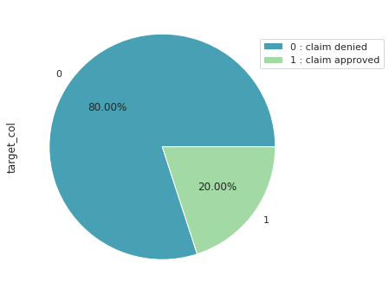
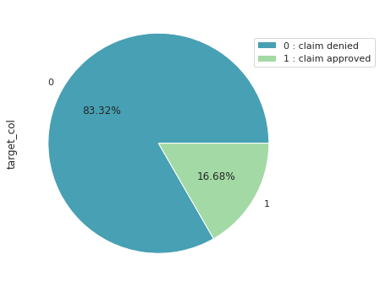
Imbalance data
Given data had imbalance in Claim so SMOTE oversampling is used to increase the count of minority.
Before Oversampling
After Oversampling
*sampling_strategy=0.25 parameter was used to increase the count.

Slide 14
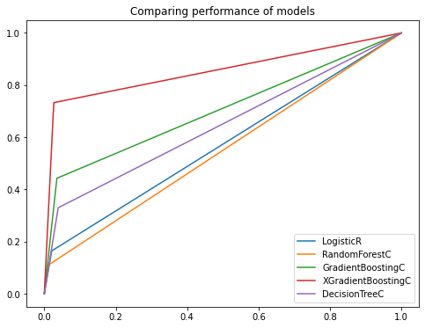
Model Selection
ROC curve and AUC score
Model | AUC score
Logistic Regression | 0.572
RandomForest | 0.549
DecisionTree | 0.704
GradientBoosting | 0.645
XGBoosting | 0.853

Slide 15
Additional Approaches Attempted
For feature selection, Recursive Feature Elimination (RFE) method
Hyperparameter tuning using Grid Search CV for XGBoost and GradientBoosting

Slide 16
Final Results
Confusion Matrix
Model: XGBoost with precision score 0.80 (post oversampling)
 | Predicted 0 | Predicted 1
Actual 0 | 11844 | 554
Actual 1 | 880 | 2219

Slide 17




Insights & Decisions
1
Annual Travel Protect Platinum and Annual Travel Protect Silver have the highest sales and lowest claim approval rate simultaneously. Good to invest/expand further on these product offerings
2
Airlines as an agency type has 3X higher claim approvals as compared to other agencies in the market. Highlights a good new/existing partnership opportunity for SafeTravel Inc.
3
More than 70% of the claims were done for travellers in the age group 20-40. Indicates that the company should target Millennials and design relevant products/offers for them
4
Approximately 98% of the products under the dataset were purchased online by travellers, indicating the dominance of the medium and opportunities in digital transformation thereof

Slide 18
Dataset - Gaps
We don’t have the data for the entire traveler universe (the people who brought the product but didn’t claim)
If we had arrival/departure dates, it would be easier to distinguish between the travel history of the customers
Profession/Organization of the traveler would have helped us generate better insights
Student Status: Would help us distinguish the longer tenure plans and effectively the different customer groups

Slide 19
Thanks

